Slide 1
ATM-01 AUTOMATED TELLER MACHINE
Presented By
K.VAIRAVAN-40124022

Slide 2
INTRODUCTION
XYZ Bank of India provides monetary service facilities to customers across many cities.
XYZ Bank of India plans to develop “Automated Teller Machine”- a web application where a customer can get services of the bank.
The scope of the Automated Teller Machine System (ATM) will be to provide the functionality as described in Functional Requirements below. The system will be developed on a window XP machine using J2EE,JSP/HTML and JDBC.

Slide 3
ADMINISTRATOR: Add/modify/delete customer details and generate account statement.
Requirement ID | Description | Priority
AD-001 | The Administrator should be able to add branch details of bank | P1
AD-002 | The Administrator should be able create customers and their account | P1
AD-003 | The Administrator should be able to modify customer details | P1
AD-004 | The Administrator should be able to delete customer details | P2
AD-005 | The Administrator should be able to verify the check dropped by customer and clear the check credits to the customer account | P1
AD-006 | The Administrator should be able to generate account statement for customer | P1
P1-First Priority P2-Second Priority

Slide 4
CUSTOMER: Perform operations withdraw/deposit cash and view balance.
Requirement ID | Description | Priority
CU-001 | The Customer should be able to change their pin | P1
CU-002 | The Customer should be able to withdraw cash (Get cash) | P1
CU-003 | The Customer should be able to withdraw cash (Fast cash) | P1
CU-004 | The Customer should be able to deposite cash (By check) | P1
CU-005 | The Customer should be able to view balance summary | P2
CU-006 | The Customer should be able to get mini statement | P1
P1-First Priority P2-Second Priority

Slide 5
AUTHENTICATION & AUTHORIZATION
Requirement ID | Description | Priority
AA-001 | All users logging into the system should be authenticated using a unique login-id and password.(Operations to be supported based on type of user) | P1

Slide 6
EXIT HANDLERS
Requirement ID | Description | Priority
EX-001 | The application should handle logout (close all open database connections , invalidate sessions etc | P1

Slide 7
INTERFACE REQUIREMENTS
The Automated Teller Machine should be developed as a GUI application using HTML/JSP screens.

Slide 8
NON FUNCTIONAL REQUIREMENT
The application should be intuitive to use and easy-to-maintain.
The application should be able to handle simultaneous requests from multiple clients.
Upon installation the Administration is expected to have default user ID and Password.
The system may force the Administrator change his password to a non default one,upon initial login.

Slide 9
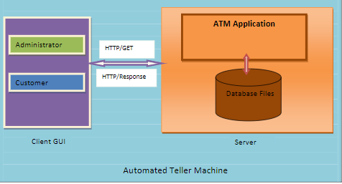

Slide 10
TARGET ENVIRONMENT
Intel hardware machine (PC P4-2.26GHz, 512 MB RAM, 40 GB HDD)
Window XP
Server- Apache Tomcat 6 or higher
Database- Oracle 9i or higher
JRE
Eclipse IDE

Slide 11
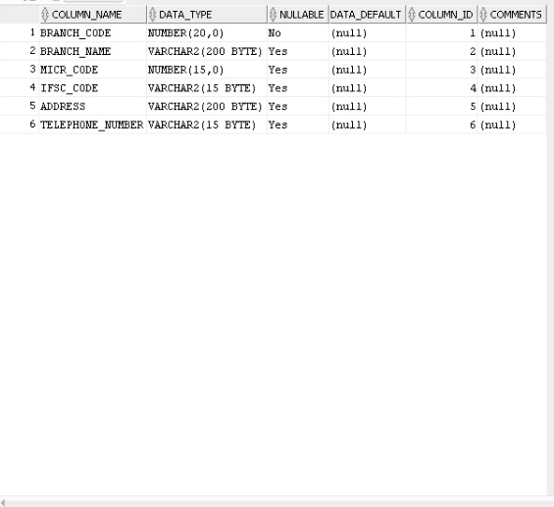
BRANCH

Slide 12
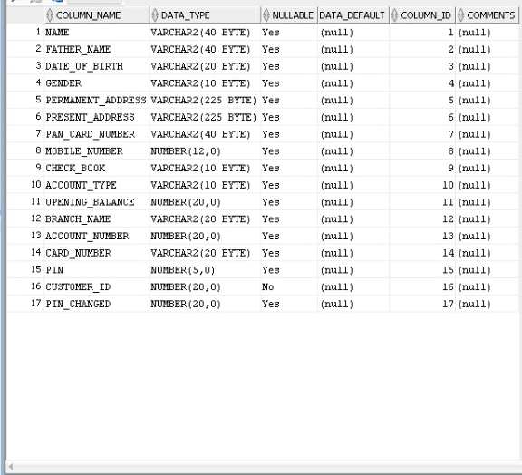
CUSTOMER DETAILS

Slide 13
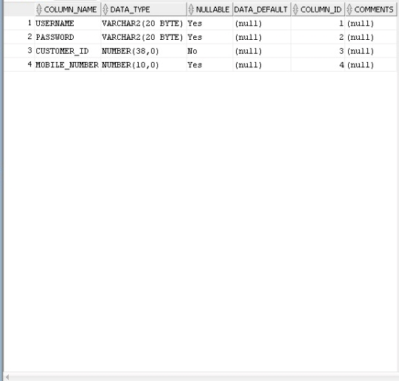
CUSTOMER

Slide 14
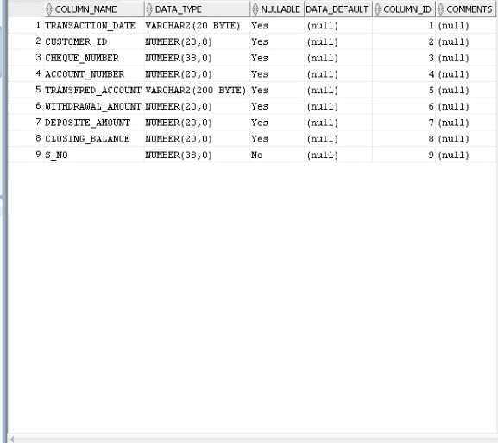
CUSTOMER TRANSCATION

Slide 15
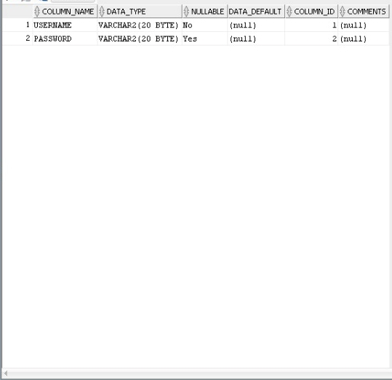
ADMIN

Slide 16
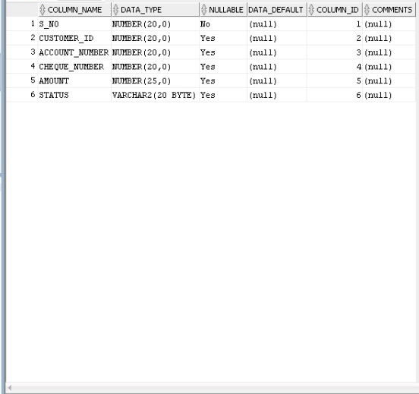
DEPOSIT

Slide 17
ASSUMPTIONS/DEPENDENCIES/LIMITATIONS
Each user will hold only one Customer ID
The Administrator can also be a customer of the bank
The number of administrators is limited to 2
The account statement will be generated for customer by the administrator based on From and To Date
A customer can open only one savings account in one branch
The Customer can withdraw cash by specifying the required amount(Get Cash)
The Customer can withdraw cash by specifying from the specified amount list (Fast Cash)
The mini statement should contain last ten transactions of the customer

Slide 18
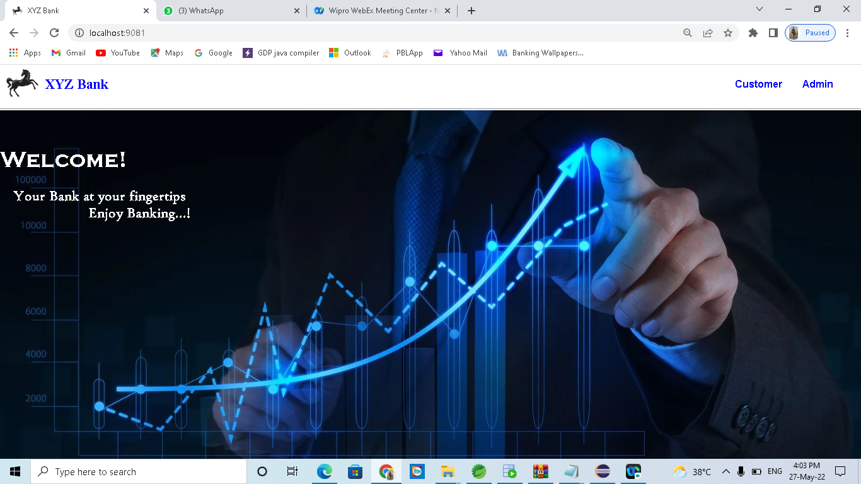
WELCOME PAGE

Slide 19
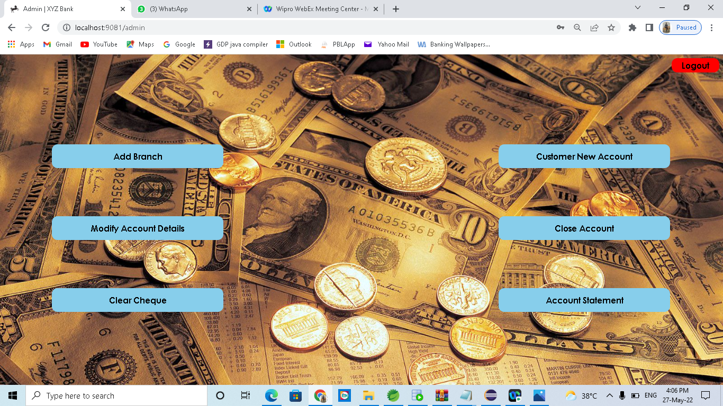
ADMIN WELCOME PAGE

Slide 20
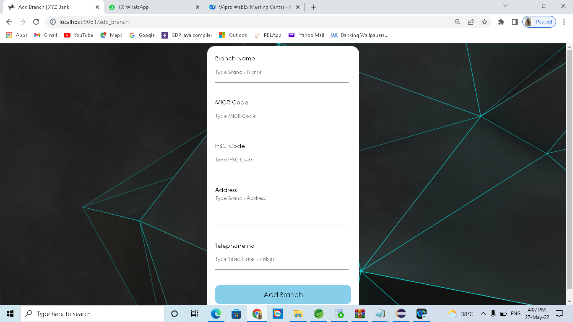
ADD BRANCH –(ADMIN)

Slide 21
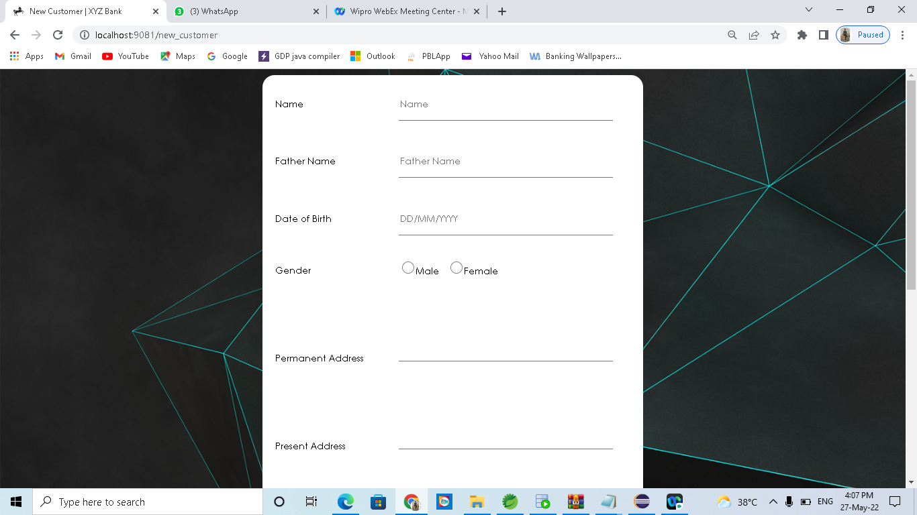
ADD NEW CUSTOMER-(ADMIN)

Slide 22
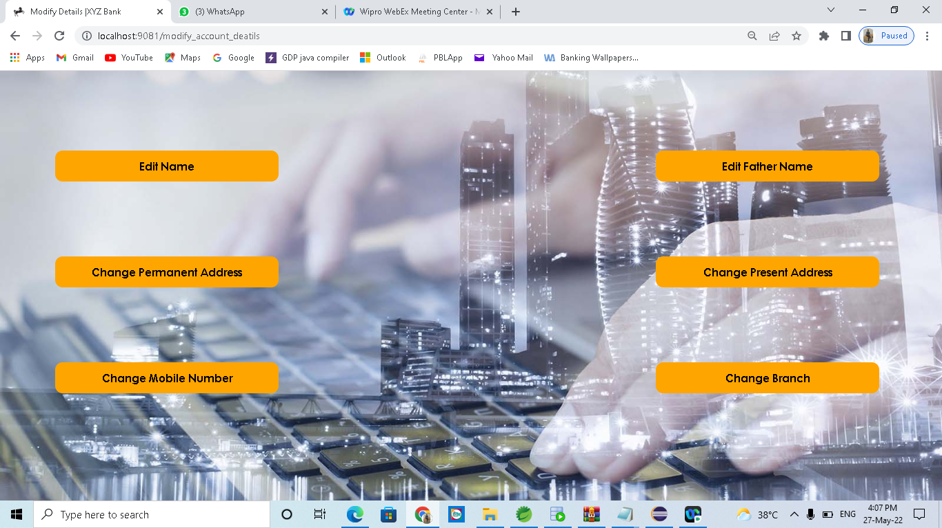
MODIFY CUSTOMER DETAILS-(ADMIN)

Slide 23
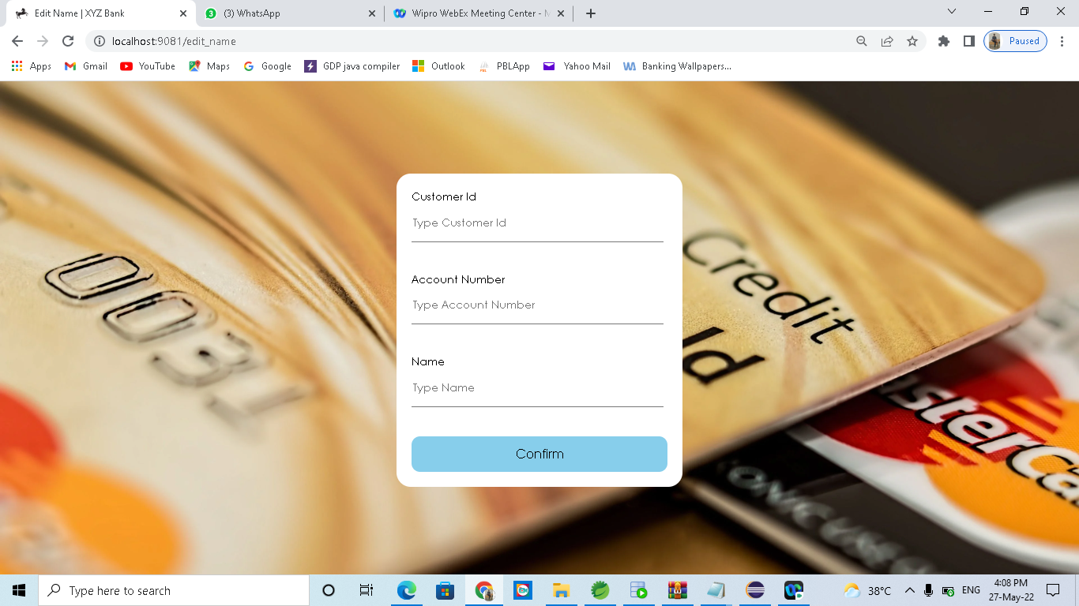
EDIT NAME-(ADMIN)

Slide 24
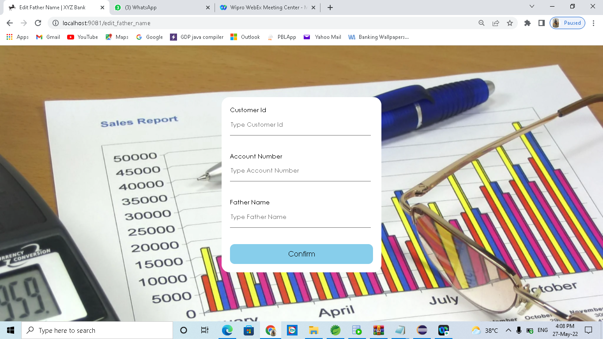
EDIT FATHERS NAME-(ADMIN)

Slide 25
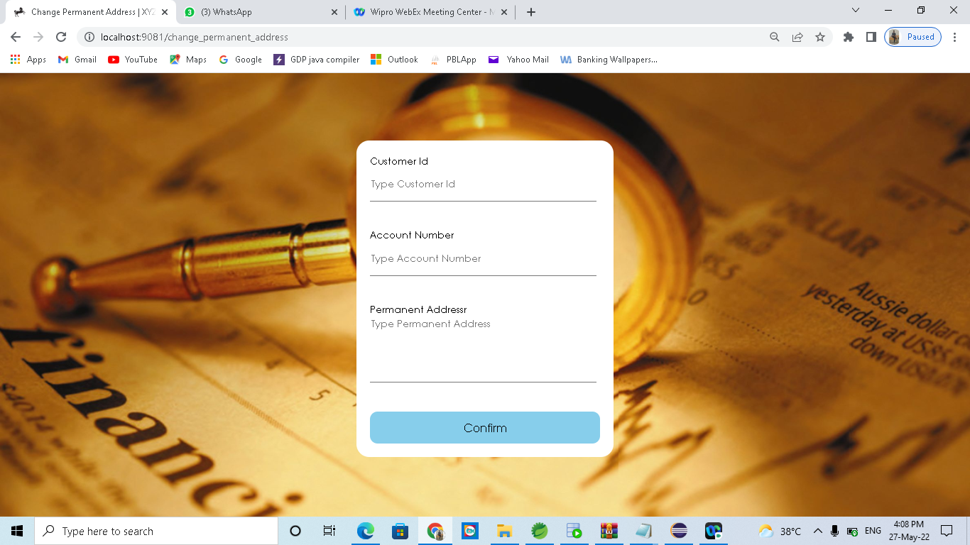
CHANGE PERMANENT ADDRESS-(ADMIN)

Slide 26
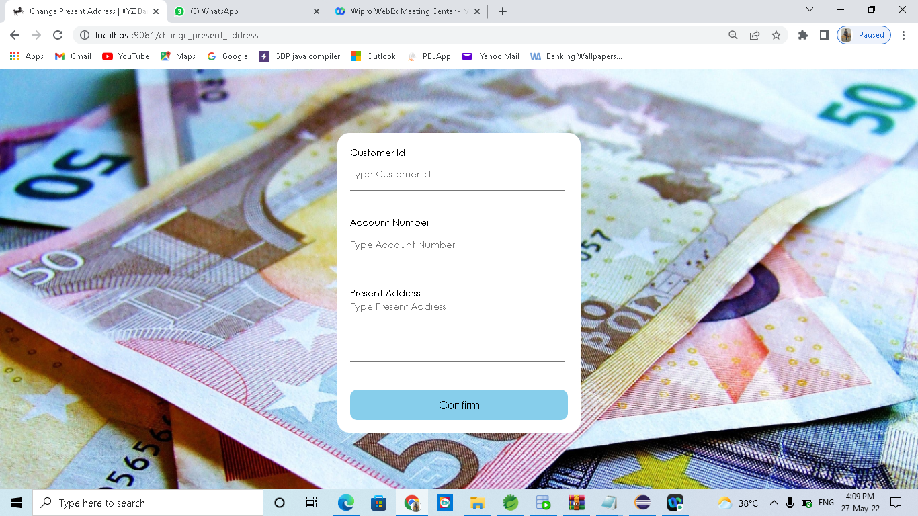
CHANGE PRESENT ADDRESS-(ADMIN)

Slide 27
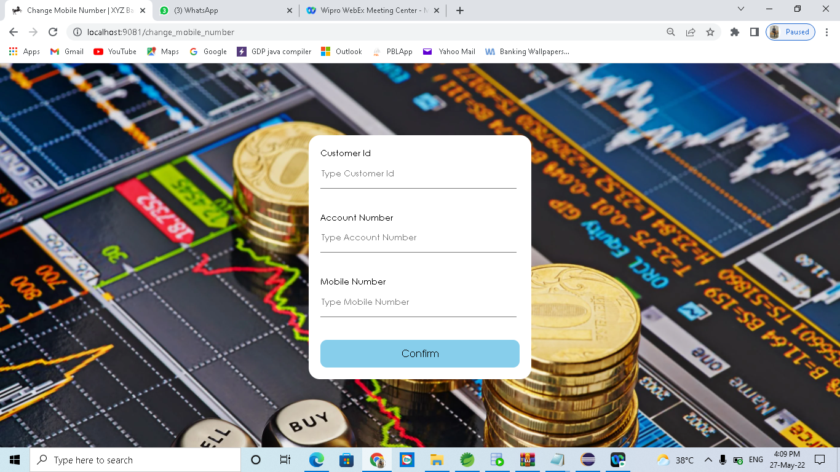
CHANGE MOBILE NUMBER

Slide 28
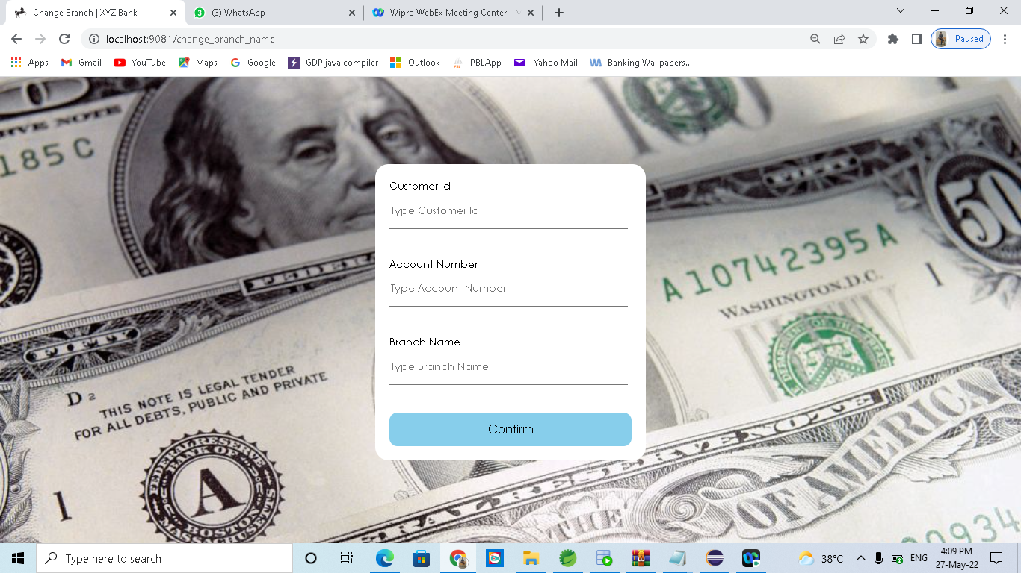
CHANGE BRANCH –(ADMIN)

Slide 29
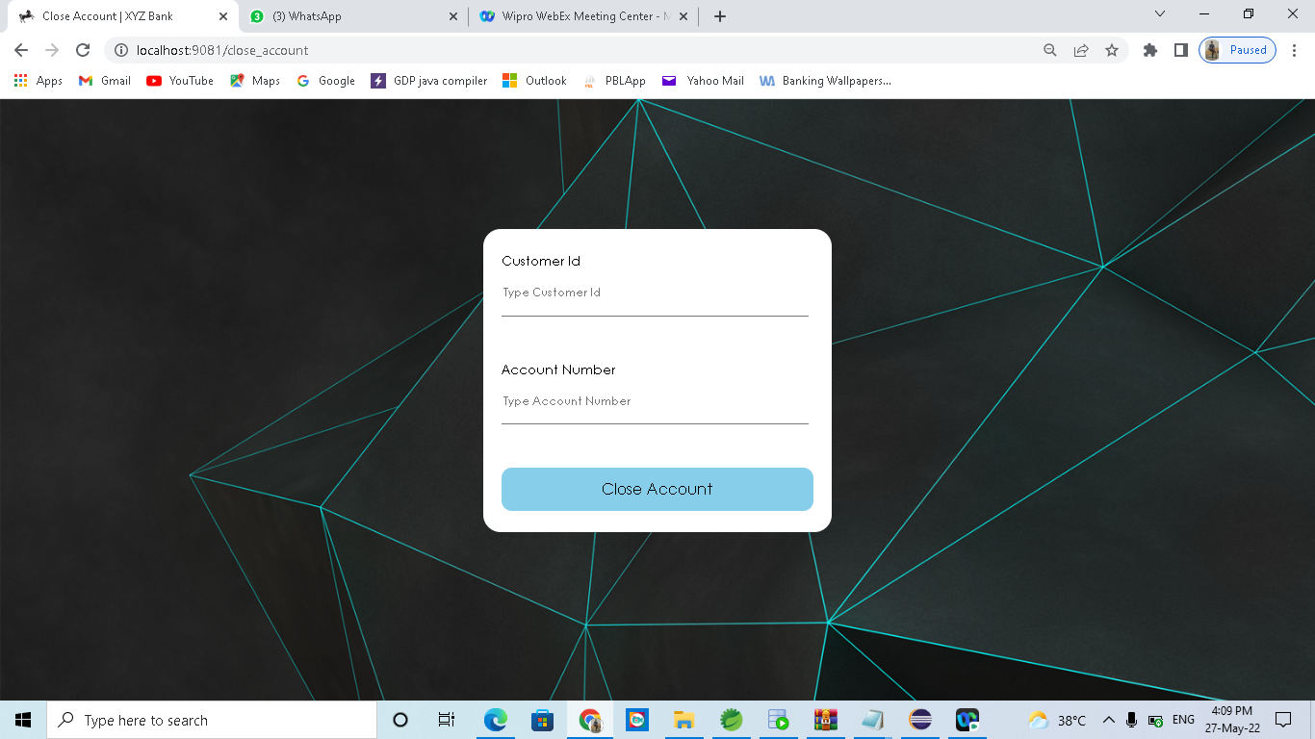
CLOSE ACCOUNT-(ADMIN)

Slide 30
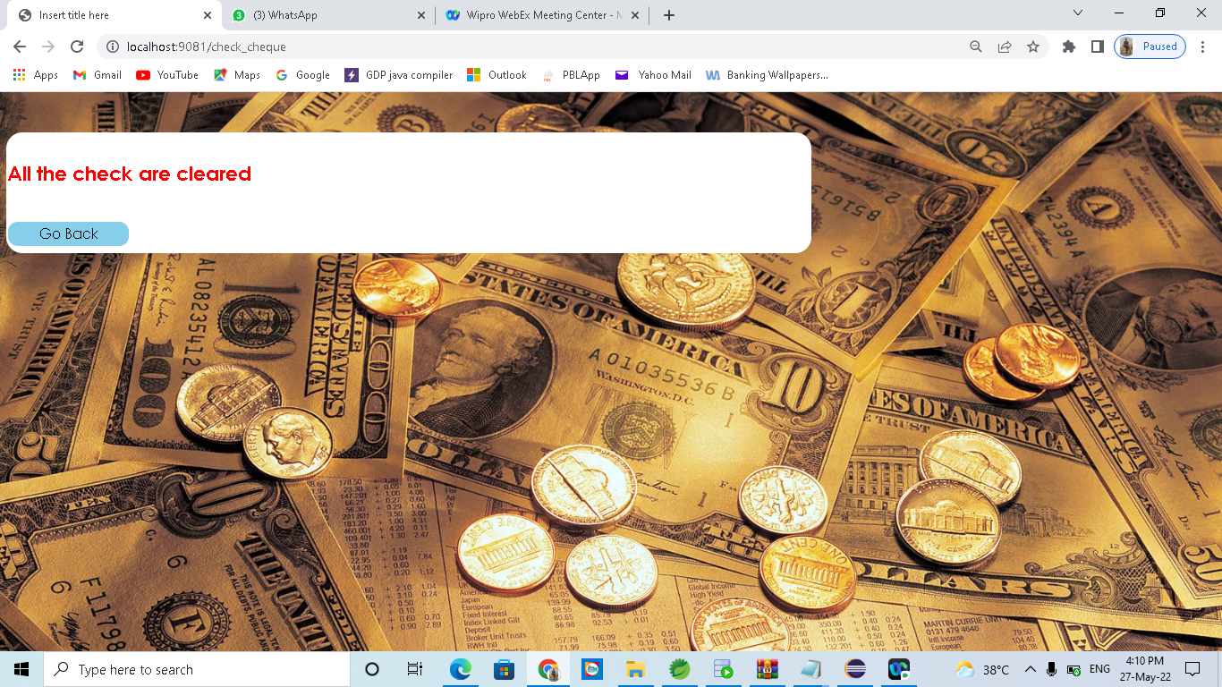
CLEAR CHEQUE –(ADMIN)

Slide 31
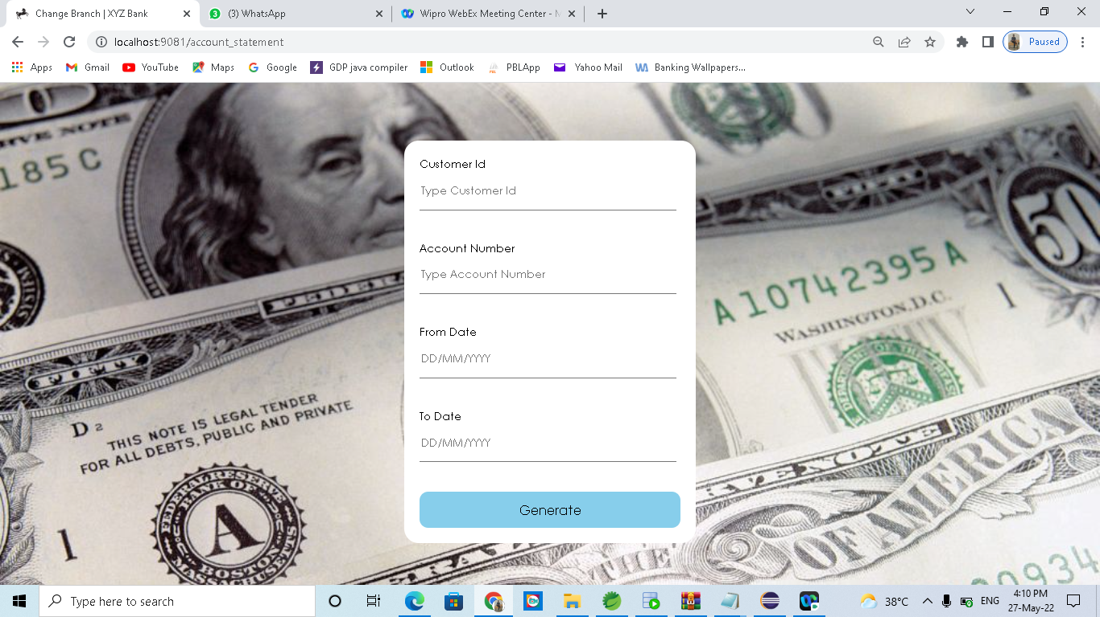
ACCOUNT STATEMENT-(ADMIN)

Slide 32
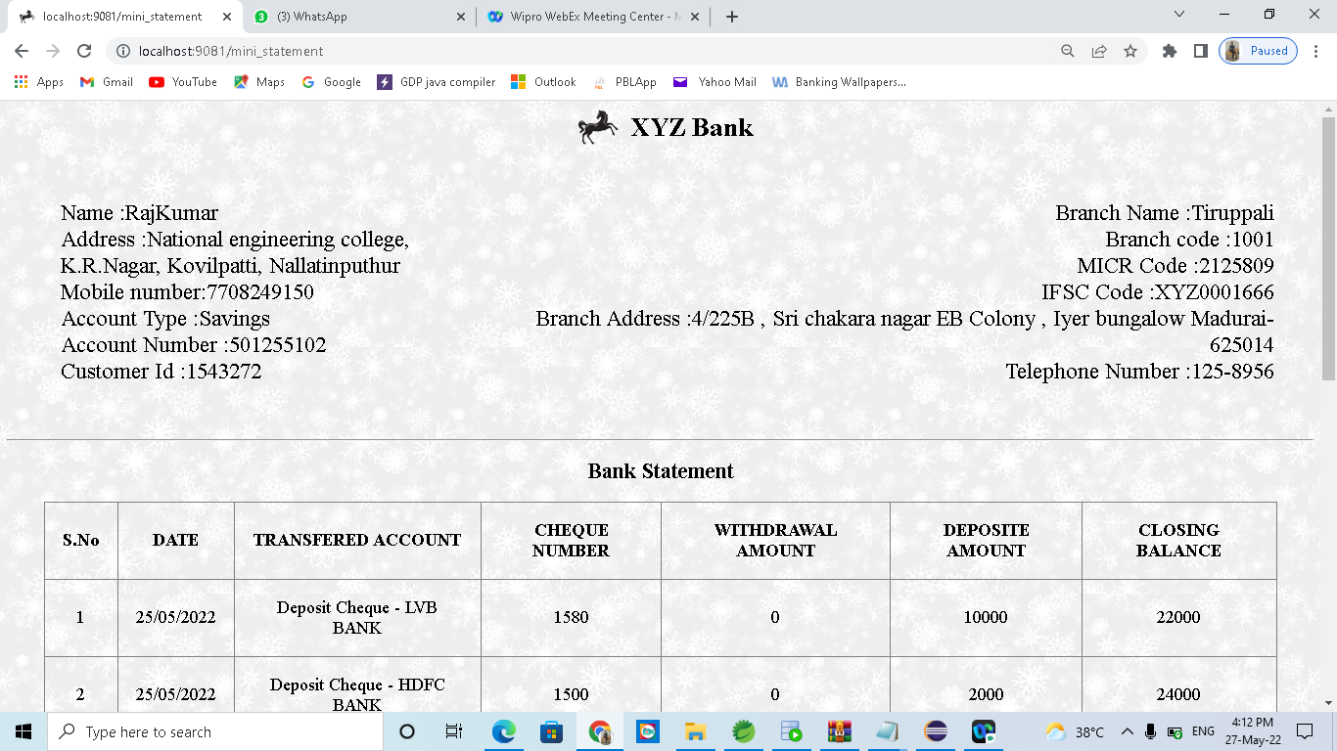
ACCOUNT STATEMENT(ADMIN)

Slide 33
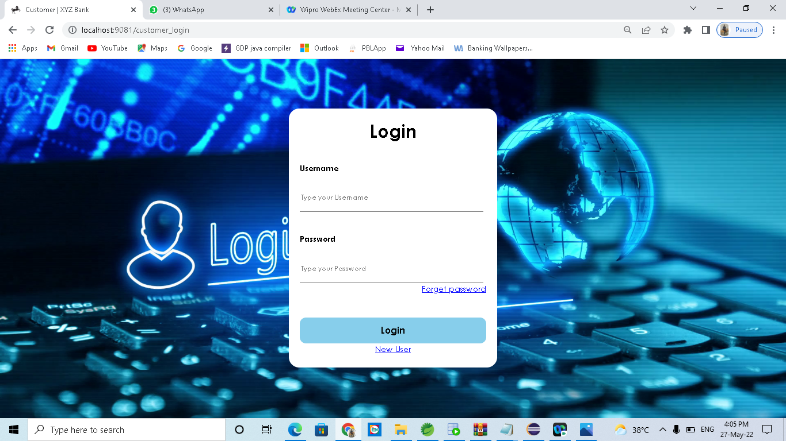
CUSTOMER LOGIN

Slide 34
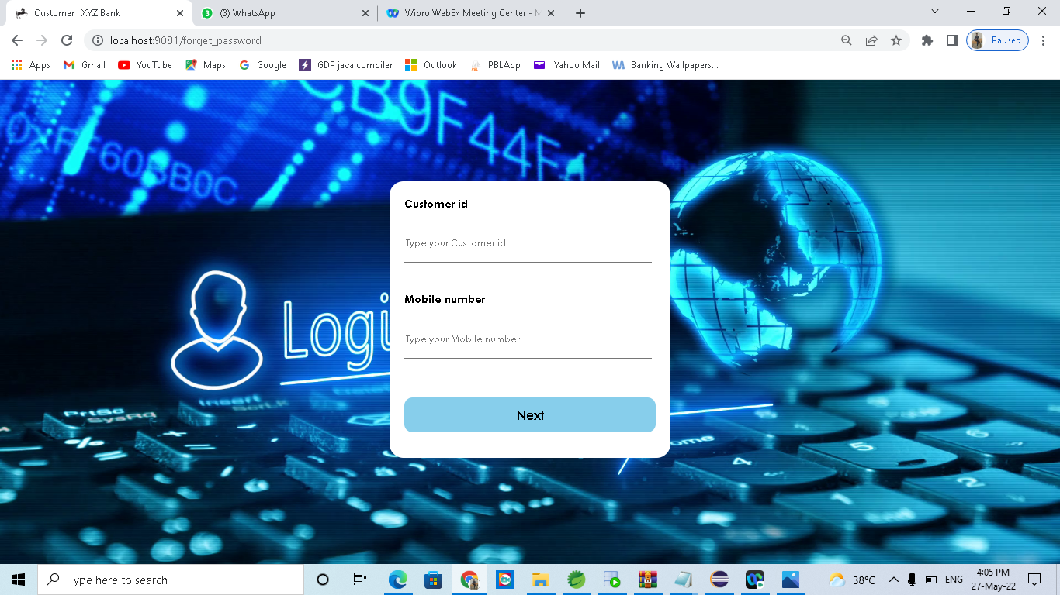
CUSTOMER FORGET PASSWORD PAGE

Slide 35
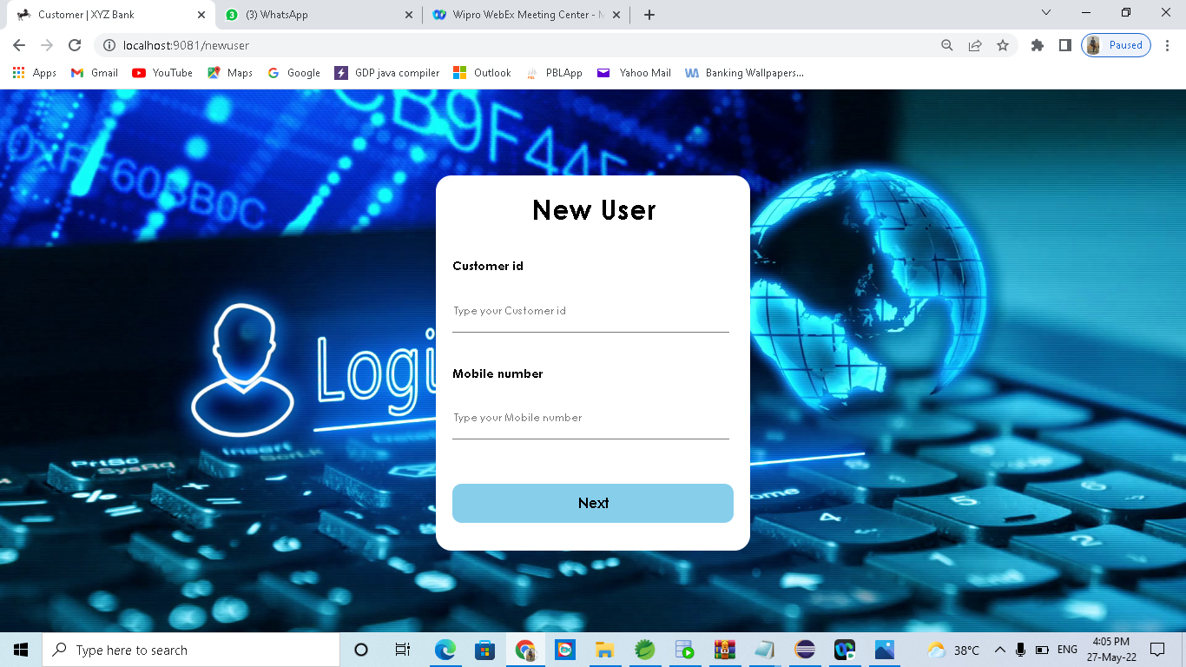
NEW USER LOGIN PAGE

Slide 36

CUSTOMER WELCOME PAGE

Slide 37
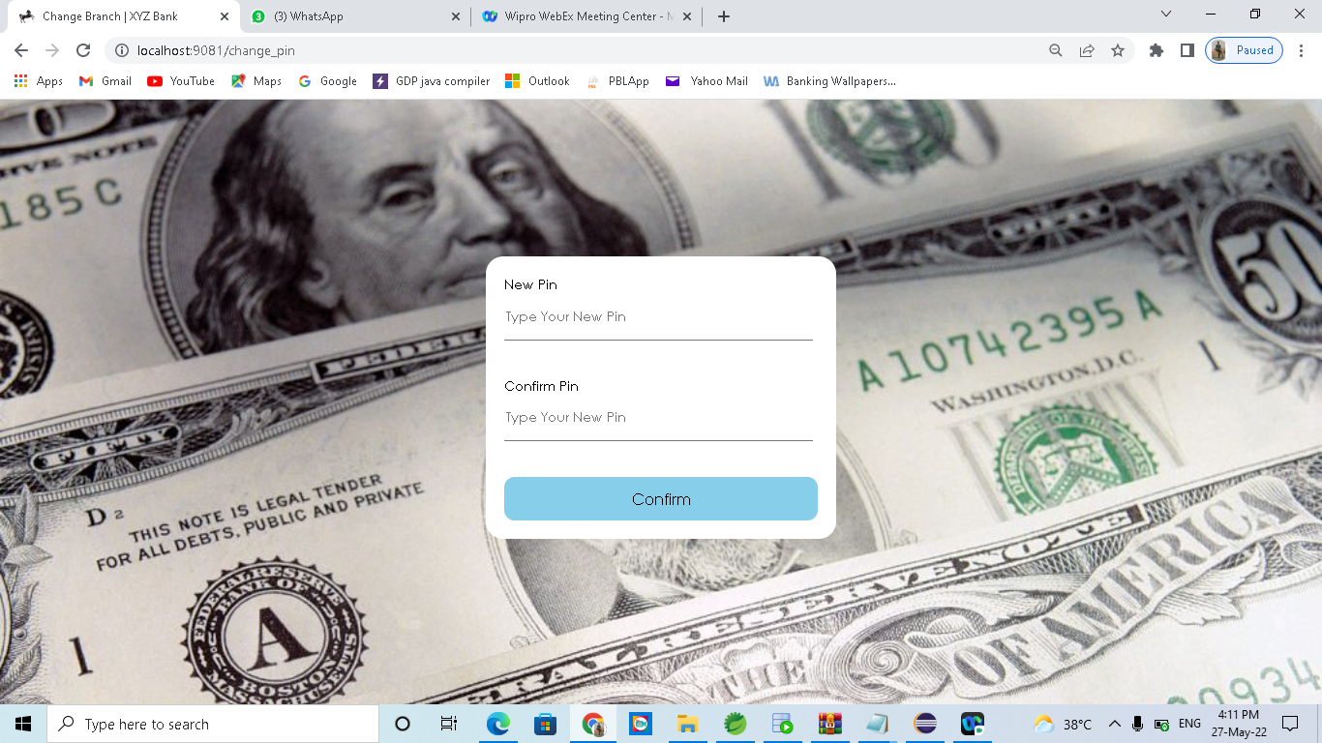
CHANGE PIN-(CUSTOMER)

Slide 38

DEPOSIT CHEQUE-(CUSTOMER)

Slide 39

FAST CASH-(CUSTOMER)

Slide 40

GET CASH-(CUSTOMER)

Slide 41
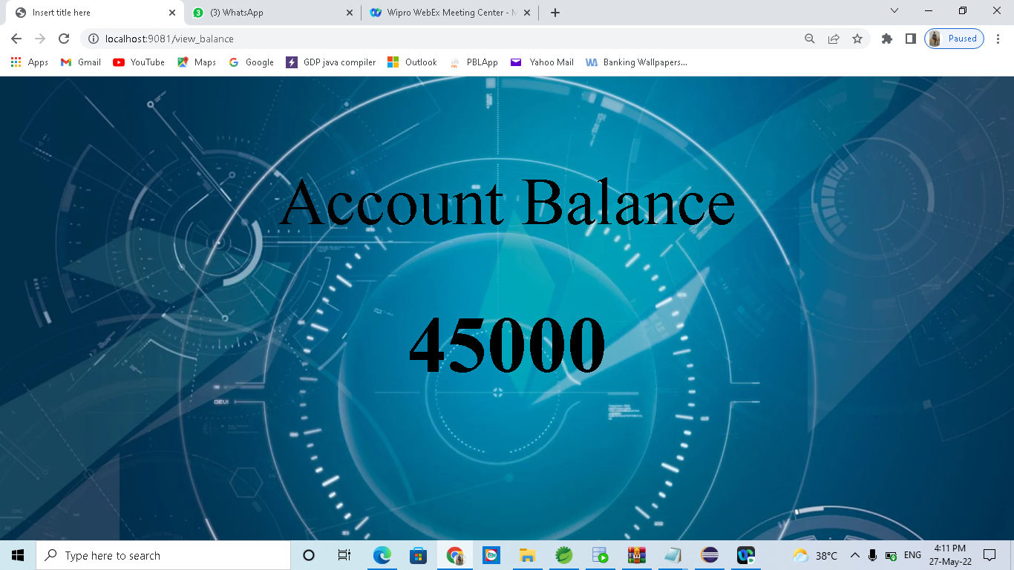
VIEW BALANCE –(CUSTOMER)

Slide 42
MINI STATEMENT-(CUSTOMER)

Slide 43
THANK YOU

